Slide 2
DXN CULTURE

Slide 3
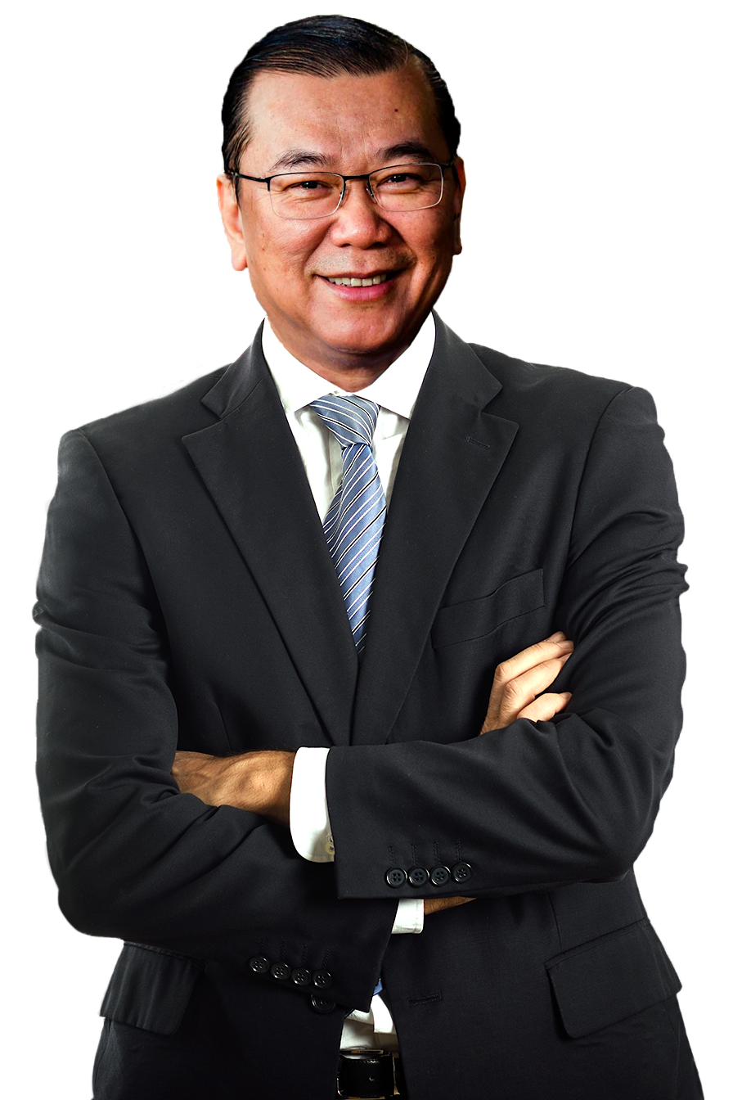
DXN CULTURE
The DXN Culture consist of the core values, principles, belief, philosophy and concepts of DXN.
It was established from the passion of the founder and CEO Dato’ Dr. Lim Siow Jin.
It forms the foundation and backbone of DXN.

Slide 4
BE A MINI DXN
Master key
You are DXN,
to become a
DXN are you
millionaire
You need to duplicate
the DXN culture

Slide 5
VISION STATEMENT
To promote Health, Wealth, and Happiness
By Dato’ Dr. Lim Siow Jin

Slide 6
VISION STATEMENT
Health should be reliable, affordable and lasting.
Wealth should be enough to realize your dreams.
Wealth should be lasting as well.
Happiness must be shared with those around you.

Slide 7
The World Health Organization ( WHO ) estimates the size of the global market for herbal products at
USD 80 billion in the year 2000
USD 200 billion in the year 2008
USD 50 trillion in the year 2050

Slide 8
DXN
PHILOSOPHY
Eka Minda
Eka Naga
Eka Pasar
Single Minded
One Dragon
One World One Market

Slide 9
BE SINGLE MINDED
Don’t look left, don’t look right, be focused
Stick to DXN long enough
Treasure what we have now with DXN

Slide 10
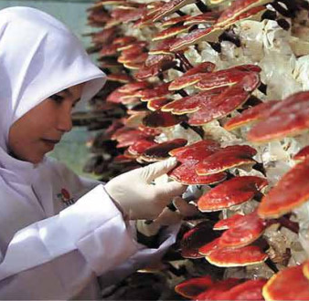
ONE DRAGON COMPANY
CULTIVATES
MANUFACTURES
DISTRIBUTES

Slide 11
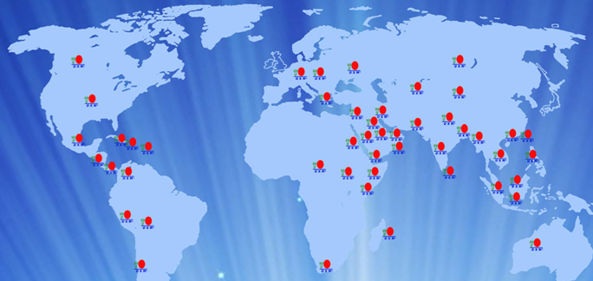
ONE WORLD, ONE MARKET
Australia, Bahrain, Bangladesh, Bolivia , Bulgaria, Canada, Chad, Chile, Czech, Colombia, Dominican Republic, Ethiopia, Greece, Hong Kong, Hungary, India, Indonesia, Jordan, Kazakhstan, Kenya, Kuwait, Malaysia, Mauritius, Mexico, Mongolia, Nepal, Nicaragua, Oman, Pakistan, Panama, Peru, Philippines, Puerto Rico, Qatar, Russia, Singapore, Slovakia, South Africa, Sri Lanka, Sudan, Thailand, UAE, USA, Yemen

Slide 12
THE MISSION
OF 3 IN 1
DISTRIBUTOR
SERVICE CENTER
MANAGEMENT

Slide 13
ALWAYS START
SMALL
Have the gut to dream big
Work extremely hard to achieve the dream
Power of submission
Never buy up the position
To become millionaire is just a game of statistics

Slide 14
PRACTICE ZERO
GEARING
Don’t spend more than what you earn
Don’t allow people to owe you
Don’t allow negative stock
Don’t owe people

Slide 15
SOLID PROFILE,
HIGH INCOME
No extravagance
Waste no money
Waste no time
Ensure highest take home bonus

Slide 16
Be the best
with positive
thinking.
Strive to be the market index
Strive to be the market leader
Strive to be the number one
DXN culture knows no limit
DXN treats problems as a challenge
The challenge is your best self
DXN treats challenges as opportunities
Accept high challenges and expect high return

Slide 17
THE MANGO THEORY

Slide 18
SYSTEM IS BUILT
FOR SUCCESS
The system for success is based on 2 key factors
Education - Learn up the training modules of DXN
Habit - Learn up the culture of DXN

Slide 19
DXN IS THE
GOLDMINE

Slide 20
THE 4 PILLARS OF DXN
Company stability
Product superiority
Generous marketing plan
Global network

Slide 21
DO THE DXN BUSINESS ALL THE TIME
Do it
all the time
Don’t do it part-time
Don’t do it full time

Slide 22
Do 30 years
job in
3 years time
Pension young
Pension wealthy
Pension healthy

Slide 23
BE A MARATHON RUNNER
Imagine yourself like a marathon runner
Enjoy all the scenery throughout the run
Don’t let the distance nor the destination bother you
Without realizing it, eventually you’ll reach the destination
Success is not a destination, but a journey.

Slide 24
IF YOU BELIEVE YOU CAN,
YOU CAN
Never stay in your comfort zone.
Learn to give up the good for the best.
Never set artificial boundaries.
Never spend too much time in what you can’t excel.
Never stop learning.
Invest time and money in education.
Change your bad habits.
No money and no time syndrome.
You must always believe that you can be successful.
To be successful, you need to get out of your comfort zone.
Don’t stay where you are. Move beyond your fear to achieve your dream.

Slide 25
BIRDS OF THE
SAME FEATHER
FLOCK TOGETHER
This is because a bird can be comfortable only in a flock of its kind.
This holds true in human beings also. If a person keeps a company of failures, that person will certainly turn out to be a failure himself.
The only way to be successful is to surround yourself with successful people.

Slide 26
Never set artificial boundaries
for yourself thinking that you can never
be successful because:
You are too old
You are too young
You are uneducated
You are too poor
You can’t be a trainer or a speaker
You can’t be a good leader
You are not professional
You can’t be a networker
You can’t give up your ego
You have a job
You can’t learn
You can’t duplicate
Etc. Etc. Etc.

Slide 27
INVEST TIME AND
EFFORT
IN EDUCATION
DXN real life education
Never stop learning
Change your bad habits.

Slide 28
DO WHAT YOU CAN
DO THE BEST
DXN
will take care of the rest

